Slide 1
Security in Computing, Fifth Edition
Chapter 12: Details of Cryptography

Slide 2
Chapter 12 Objectives
Learn basic terms and primitives of cryptography
Deep dive into how symmetric encryption algorithms work
Study the RSA asymmetric encryption algorithm
Compare message digest algorithms
Explain the math behind digital signatures
Learn the concepts behind quantum cryptography

Slide 3
Methods of Cryptanalysis
Break (decrypt) a single message
Recognize patterns in encrypted messages
Infer some meaning without even breaking the encryption, such as from the length or frequency of messages
Easily deduce the key to break one message and perhaps subsequent ones
Find weaknesses in the implementation or environment of use of encryption by the sender
Find general weaknesses in an encryption algorithm
Notes:
We start with a brief discussion of cryptanalysis because an understanding of what attackers are trying to accomplish (and how they are trying to accomplish it) informs the study of how to protect data from them. The methods listed here are not mutually exclusive, and which ones are applied will depend on a number of factors:
Expertise of the attacker
What information is available to the attacker
What access is available to the attacker
Other constraints, such as time

Slide 4
Cryptanalysis Inputs
Ciphertext only
Look for patterns, similarities, and discontinuities among many messages that are encrypted alike
Plaintext and ciphertext, so the cryptanalyst can see what transformations occurred
Known plaintext
Probable plaintext
Chosen plaintext
Notes:
Known plaintext—the analyst has an exact copy of the plaintext and ciphertext
Probable plaintext—message is very likely to have certain content, such as a date header
Chosen plaintext—the attacker gains sufficient access to the system to generate ciphertext from arbitrary plaintext inputs

Slide 5
Cryptographic Primitives
Substitution
One set of bits is exchanged for another
Transposition
Rearranging the order of the ciphertext to break any repeating patterns in the underlying plaintext
Confusion
An algorithm providing good confusion has a complex functional relationship between the plaintext/key pair and the ciphertext, so that changing one character in the plaintext causes unpredictable changes to the resulting ciphertext
Diffusion
Distributes the information from single plaintext characters over the entire ciphertext output, so that even small changes to the plaintext result in broad changes to the ciphertext
Notes:
These are the basic techniques that make up cryptographic algorithms. As we study some algorithms in depth later in the chapter, we’ll see these again and again. The first two—substitution and transposition—are simple mathematical operations used within complex cryptosystems. The latter two—confusion and diffusion—are more conceptual and may be accomplished in a number of different ways depending on the cryptographic algorithm.

Slide 6
One-Time Pads
Notes:
This is a diagram of the Vernam cipher, a type of one-time pad. A one-time pad is often used as an example of the perfect cipher, but it is only useful as a concept, as it is completely impractical. A one-time pad is a substitution cipher that uses an arbitrarily large, nonrepeating set of keys for substitution (in the diagram of the Vernam cipher, XOR is used instead of pure substitution), and requires both an unlimited set of completely random keys and absolute synchronization between sender and receiver, both of which are impractical. In terms of resistance to cryptanalysis, the one-time pad is the gold standard against which other encryption algorithms are measured, as it offers no patterns for attackers to analyze.

Slide 7
Shannon’s Characteristics of Good Ciphers
The amount of secrecy needed should determine the amount of labor appropriate for the encryption and decryption
The set of keys and the enciphering algorithm should be free from complexity
The implementation of the process should be as simple as possible
Errors in ciphering should not propagate and cause corruption of further information in the message
The size of the enciphered text should be no larger than the text of the original message
Notes:
The degree of secrecy required factors into questions such as key length and number of rounds and should be based on implementation of the algorithm, current and predicted speeds of computers, and resources of likely attackers.
The process has to work on any kind of plaintext input, and keys should be easy for users to generate, transmit, and store.
As we saw earlier in the book, complexity is the enemy of good security analysis. It is easier to identify flaws in, and to correctly implement, a simpler algorithm, and a simpler algorithm is therefore more likely to be free of flaws.
Communication errors do happen, and when they do, the need for retransmission should be as limited as possible.
A ciphertext that expands dramatically in size cannot possibly carry more information than the source plaintext, yet it gives the cryptanalyst more data from which to infer a pattern. Larger messages also require more transmission time and storage and are therefore less practical for users.

Slide 8
Properties of a Trustworthy Cryptosystem
It is based on sound mathematics
It has been analyzed by competent experts and found to be sound
It has stood the test of time
Notes:
Good cryptographic algorithms are derived from sound principles and have security properties that are proven by expert mathematicians. Historically, algorithms that have not met this standard have been easily broken. Because cryptographic algorithms are complex, it can take years of analysis before serious flaws are identified.

Slide 9
DES Algorithm
Notes:
We first explained symmetric cryptography and introduced DES in Chapter 2. Here we look in detail at how DES works. While DES is no longer practical for use against modern technology, the algorithm has a combination of strong fundamentals and relative simplicity that makes it useful for teaching how symmetric encryption actually works. This diagram shows a single DES cycle. Once this cycle is explained, we’ll look at a more complete representation of the DES process.
Input to DES is divided into blocks of 64 bits (not shown)
The data bits are permuted by an “initial permutation” (not shown)
The key is reduced from 64 bits to 56 bits (parity bits are removed) (not shown)
The 64 permuted data bits are broken into a left half and right half
The 32-bit right half is expanded to 58 bits by repeating certain bits
The key is reduced to 48 bits by choosing only certain bits according to tables called S-boxes (S-boxes are not shown for simplicity)
The key is shifted left by a number of bits and also permuted
The key is combined with the right half, which is then combined with the left half
The result of these combinations becomes the new right half, while the old right half becomes the new left half

Slide 10
DES Algorithm (cont.)
Notes:
This is a much more complete view of the DES algorithm, showing three cycles along with the initial permutation and the final permutation. We’ll zoom in on the following slides.

Slide 11
DES Algorithm (cont.)
Notes:
Here we see where the initial permutation fits in before the first cycle.

Slide 12
DES Algorithm (cont.)
Notes:
Here we see how each cycle connects to the last.

Slide 13
DES Algorithm (cont.)
Notes:
Here we see that the final permutation is an inverse of the initial permutation, performed against the outputs of the final cycle.

Slide 14
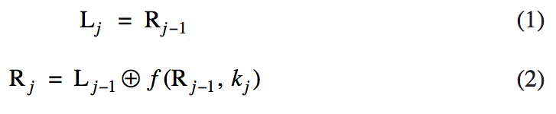
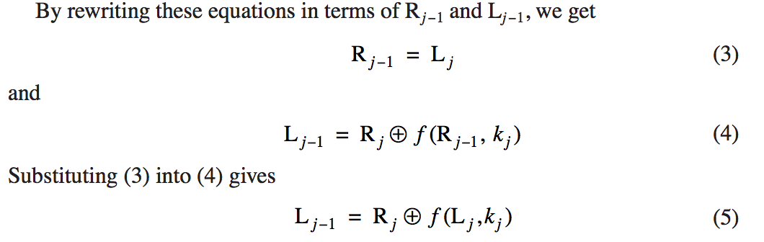
DES Decryption
Notes:
In DES, a single algorithm is used for both encryption and decryption. In these equations describing a single DES cycle, L is the left-half input, R is the right-half input, j is the current cycle, k is the key for the current cycle, and f is the function computed in an expand-shift-substitute-permute cycle. Equations (3) and (5) show that R and L for the previous cycle can be derived entirely from R and L of the current cycle, demonstrating that the DES algorithm can work in reverse.

Slide 15
Chaining
DES uses the same process for each 64-bit block, so two identical blocks encrypted with the same key will have identical output
This provides too much information to an attacker, as messages that have common beginnings or endings, for example, are very common in real life, as is reuse of a single key over a series of transactions
The solution to this problem is chaining, which makes the encryption of each block dependent on the content of the previous block as well as its own content
Notes:
While we write about chaining in the context of DES, this is a general problem for which chaining is a general solution.

Slide 16
Simple Chaining Example
Notes:
In this simple chaining example, the input of the second block is an XOR of the output of the first block and the plaintext of the second block. This has the effect of making identical plaintext in two different messages produce completely different ciphertext. But what about the first block? We’ll look at that on the next slide.

Slide 17
Initialization Vectors
Notes:
To protect against the problem of identical first blocks, we start with an initialization vector—an unpredictable (usually random) value that changes for each message, so that the positive effect of chaining can be useful even for the first block of data.

Slide 18
Structure of AES
Notes:
AES is much more complex than DES, and we will not explain it in detail here. The goal of this chapter is to provide a high-level understanding of how and why these algorithms work. For a detailed understanding, a full course dedicated to cryptography is appropriate.
The algorithm consists of 10, 12, or 14 cycles, for a 128-, 192-, or 256-bit key, respectively. Each cycle consists of four steps:
Byte substitution. This step substitutes each byte of a 128-bit block according to a substitution table. This is a straight diffusion operation.
Shift row. Certain bits are shifted to other positions. This is a straight confusion operation.
Mix column. This step involves shifting left and XORing bits with themselves. These operations deliver both confusion and diffusion.
Add subkey. Here, a portion of the key unique to this cycle is XORed with the cycle result. This operation delivers confusion and incorporates the key.
Each cycle performs both confusion and diffusion as well as blends the key into the result.

Slide 19
Longevity of AES
Since its initial publication in 1997, AES has been extensively analyzed, and the only serious challenges to its security have been highly specialized and theoretical
Because there is an evident underlying structure to AES, it will be possible to use the same general approach on a slightly different underlying problem to accommodate keys larger than 256 bits when necessary
No attack to date has raised serious question as to the overall strength of AES

Slide 20
Asymmetric Encryption with RSA
Since its introduction in 1978, RSA has been the subject of extensive cryptanalysis, and no serious flaws have yet been found
The encryption algorithm is based on the underlying problem of factoring large prime numbers, a problem for which the fastest known algorithm is exponential in time
Two keys, d and e, are used for decryption and encryption (they are interchangeable)
The plaintext block P is encrypted as P^{e} mod n
The decrypting key d is chosen so that (P^{e})^{d} mod n = P

Slide 21
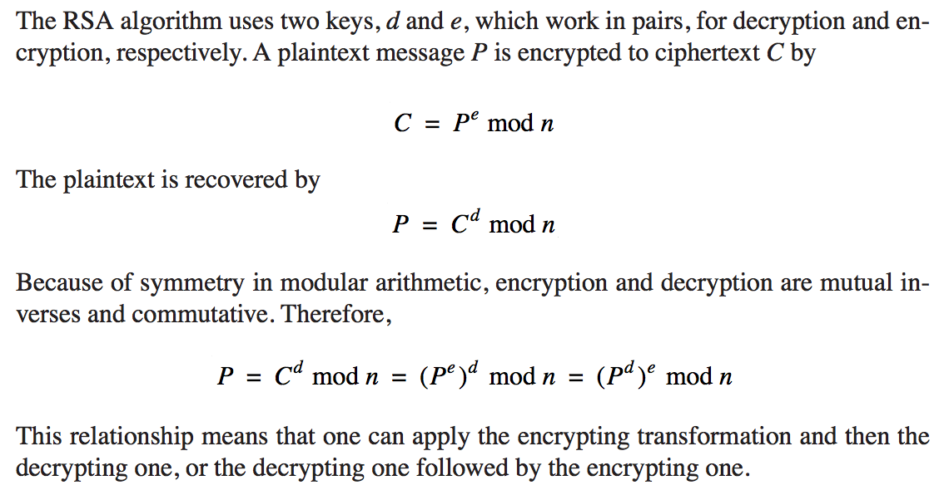
Detailed Description of RSA
Notes:
Because of the hard problem on which it is based, the RSA algorithm is elegant in its simplicity and analyzability.

Slide 22
Deriving an RSA Key Pair
The encryption key consists of the pair of integers (e, n), and the decryption key is (d, n)
The value of n should be quite large, a product of two primes, p and q
Typically, p and q are nearly 100 digits each, so n is approximately 200 decimal digits (about 512 bits) long
A large value of n effectively inhibits factoring n to infer p and q (but time to encrypt increases as the value of n grows larger)
A relatively large integer e is chosen so that e is relatively prime to (p − 1) * (q − 1). An easy way to guarantee that e is relatively prime to (p − 1) * (q − 1) is to choose e as a prime that is larger than both (p − 1) and (q − 1)
Finally, select d such that e * d = 1 mod (p − 1) * (q − 1)
Notes:
These days, 2048-bit keys are increasingly becoming a standard requirement (thanks to increased computing power). The user of RSA distributes the value of e and n and keeps d secret.

Slide 23
Message Digests
Previously introduced in Chapter 2, message digests are ways to detect changes to a block of data
One-way hash functions are cryptographic functions with multiple uses:
They are used in conjunction with public-key algorithms for both encryption and digital signatures
They are used in integrity checking
They are used in authentication
They are used in communications protocols
Modern hash functions meet two criteria:
They are one-way, meaning they convert input to a digest, but it is infeasible to start with a digest value and infer the input
They do not have obvious collisions, meaning that it is infeasible to find a pair of inputs that produce the same digest

Slide 24
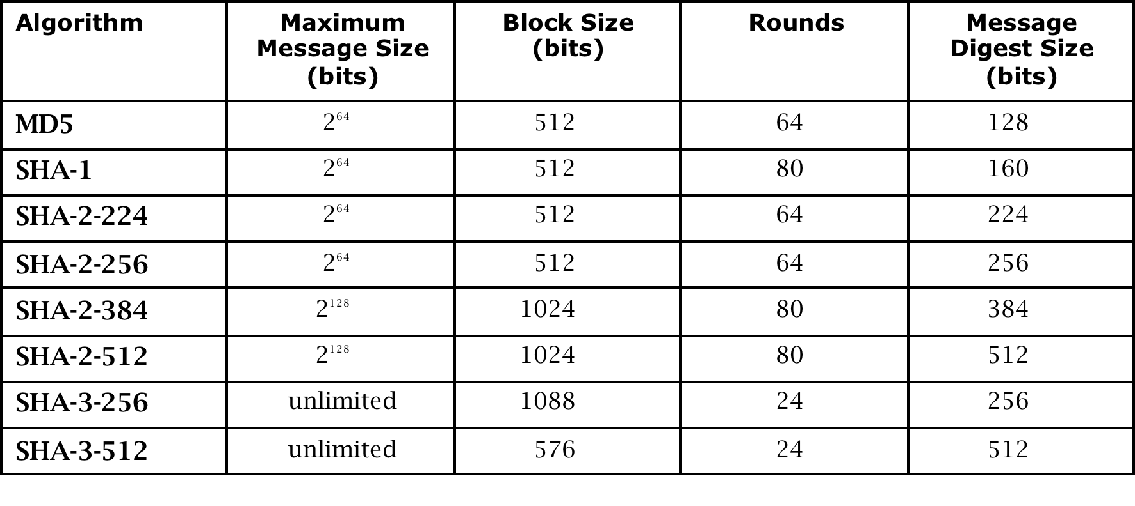
Properties of Current Hash Standards
Notes:
In practice, for security purposes, MD5 and SHA-1 are too weak for modern use. SHA-3 has much better processing performance than its predecessors, but it is relatively new and has not yet stood the test of time (nor have its implementations).

Slide 25
Digital Signatures
As we initially saw in Chapter 2, digital signatures must meet two requirements and, ideally, satisfy two more:
Unforgeable (mandatory): No one other than the signer can produce the signature without the signer’s private key
Authentic (mandatory): The receiver can determine that the signature really came from the signer
Not alterable (desirable): No signer, receiver, or any interceptor can modify the signature without the tampering being evident
Not reusable (desirable): Any attempt to reuse a previous signature will be detected by receiver
The general way of computing digital signatures is with public key encryption:
The signer computes a signature value by using a private key
Others can use the public key to verify that the signature came from the corresponding private key

Slide 26
Elliptic Curve Cryptosystems
While the RSA algorithm appears sufficiently strong, it has a different kind of flaw: It is patented
An alternative form of asymmetric cryptography comes in the form of Elliptic Curve Cryptography (ECC)
ECC has two advantages over RSA:
While some technologies using ECC are patented, the general algorithm is in the public domain
ECC can provide similar security to RSA using a shorter key length
Notes:
ECC use very complex math that is unnecessarily deep for this course, so we describe them here only at the highest level.

Slide 27
Quantum Cryptography
Based on physics, not mathematics, using light particles called photons
It relies on our ability to measure certain properties of photons and on Heisenberg’s uncertainty principle, which allows senders and receivers in quantum communication to easily detect eavesdroppers
Implementations of quantum cryptography remain in the prototype stage, as creating practical photon guns and receivers is technically difficult
While still not ready for widespread adoption, quantum cryptography may be practical within the next decade and would likely be a significant improvement over existing systems for encrypted communication
Notes:
We deliberately do not go into great detail in these slides, as this is not a physics course. The goal here is for students to understand how quantum cryptography might impact security in the relatively near future. For more detail on the physics of quantum computing, see the textbook.

Slide 28
Summary
Substitution, transposition, confusion, and diffusion are the basic primitives of cryptography
DES is a relatively simple symmetric algorithm that, although no longer practical, is useful for studying technique
Chaining and random initialization vectors are important techniques for preventing ciphertext repetition
AES remains the modern standard for symmetric encryption almost 20 years after its introduction
RSA is a popular and deceptively simple algorithm for asymmetric cryptography
Message digests use one-way cryptographic hash functions to detect message modification
Digital signatures use asymmetric encryption to detect forged messages
While not yet ready for mainstream use, quantum cryptography will likely be a significant improvement over modern encrypted communication

